Slide 1
Airline Safety
By Zack DeNoto

Slide 2
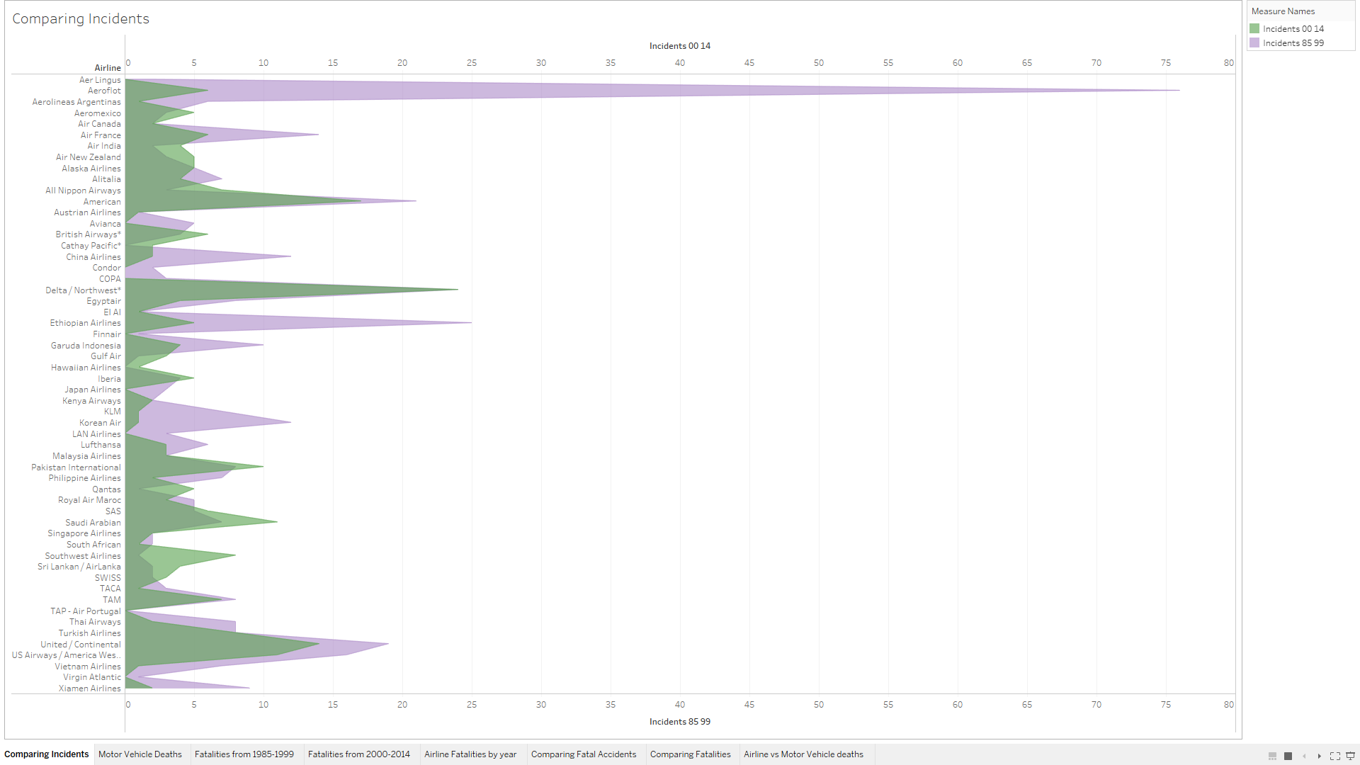
Comparing Airline Incidents
The number of airline incidents has decreased from the period of 1985-1999 compared to the period of 2000-2014.

Slide 3
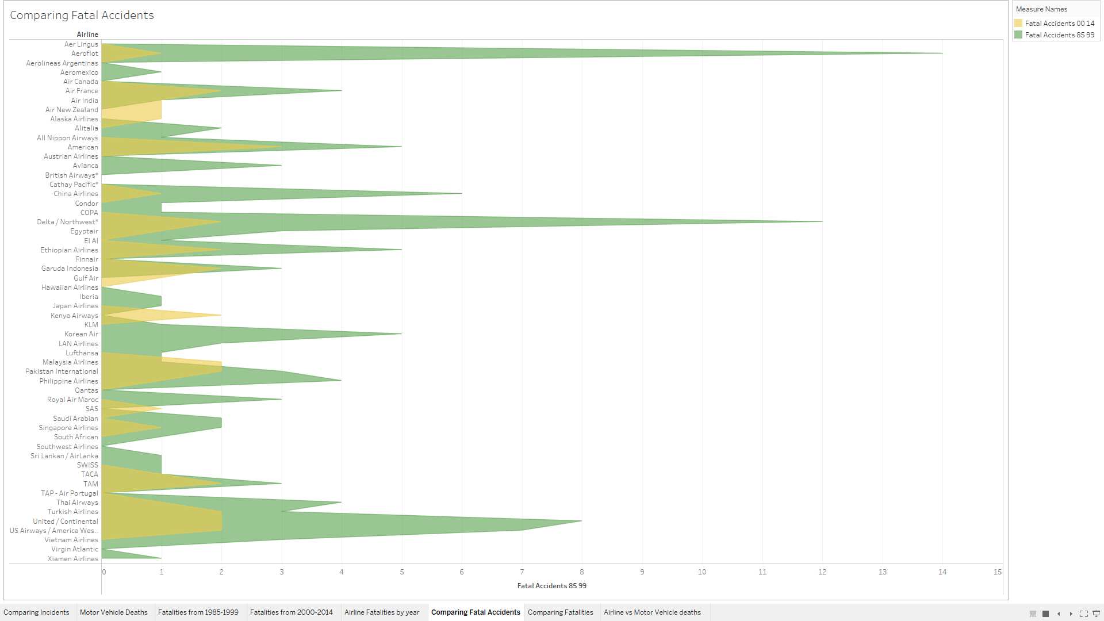
Comparing Fatal Airline Incidents
The number of fatal airline incidents has also decreased from the period of 1985-1999 compared to the period of 2000-2014.

Slide 4
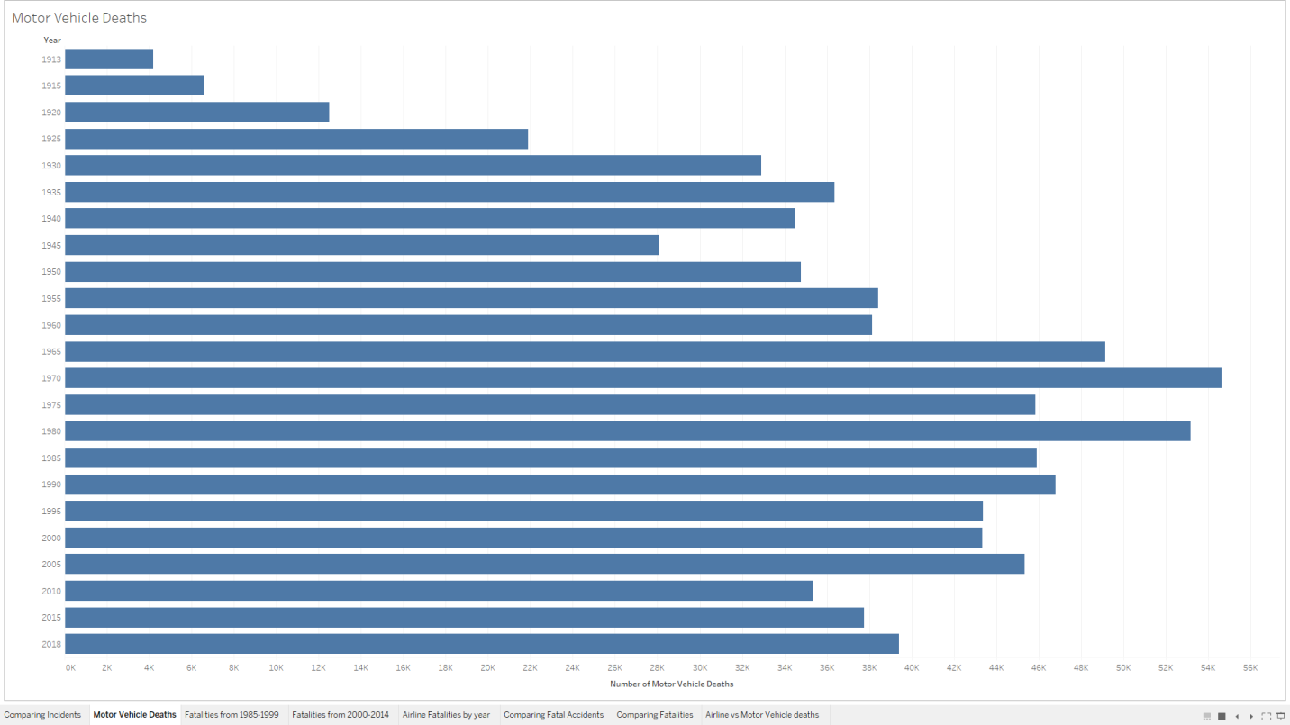
Motor Vehicle Deaths
The number of motor vehicle deaths has increased from 1918 to 2018 with no steady decline.

Slide 5
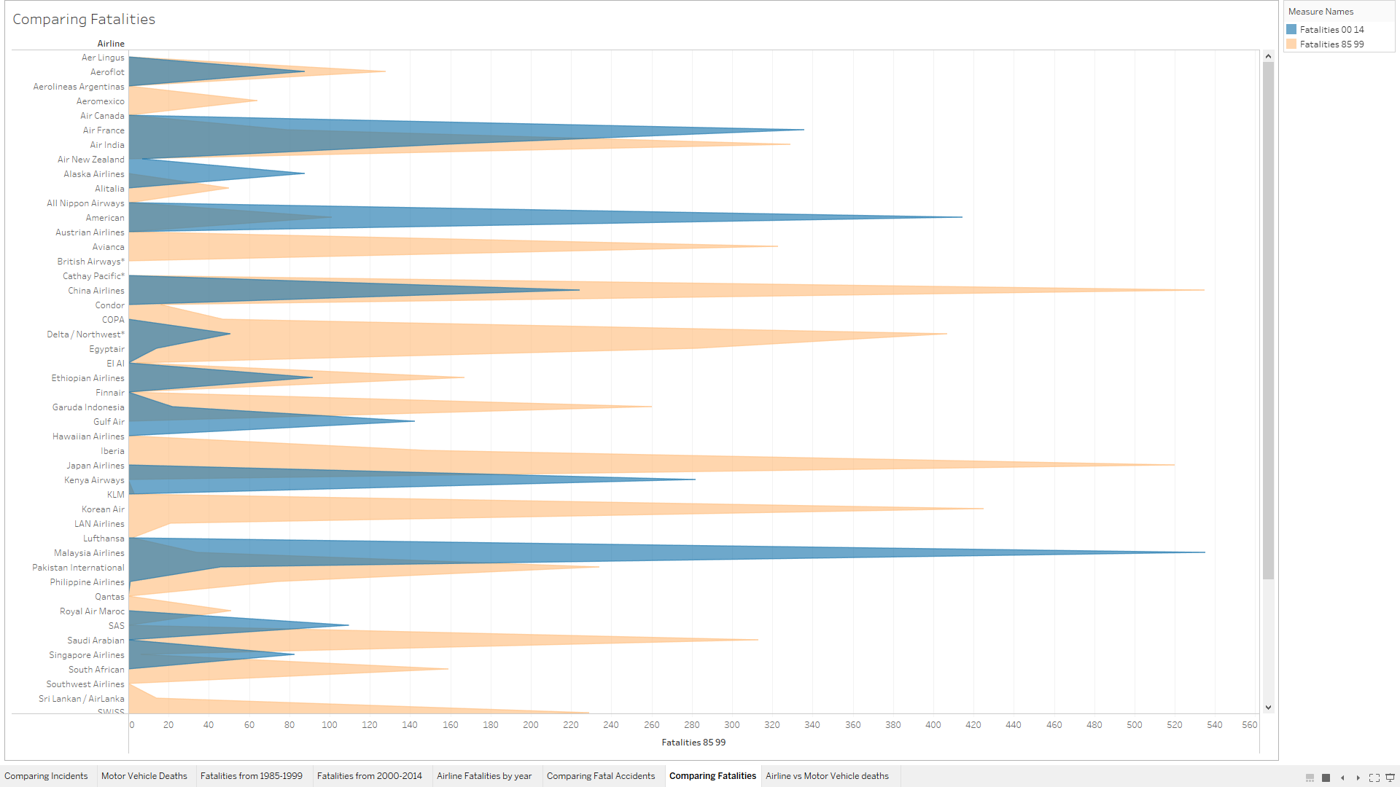
Comparing Airline Deaths
The number of airline deaths has decreased from the period of 1985-1999 compared to the period of 2000-2014.

Slide 6
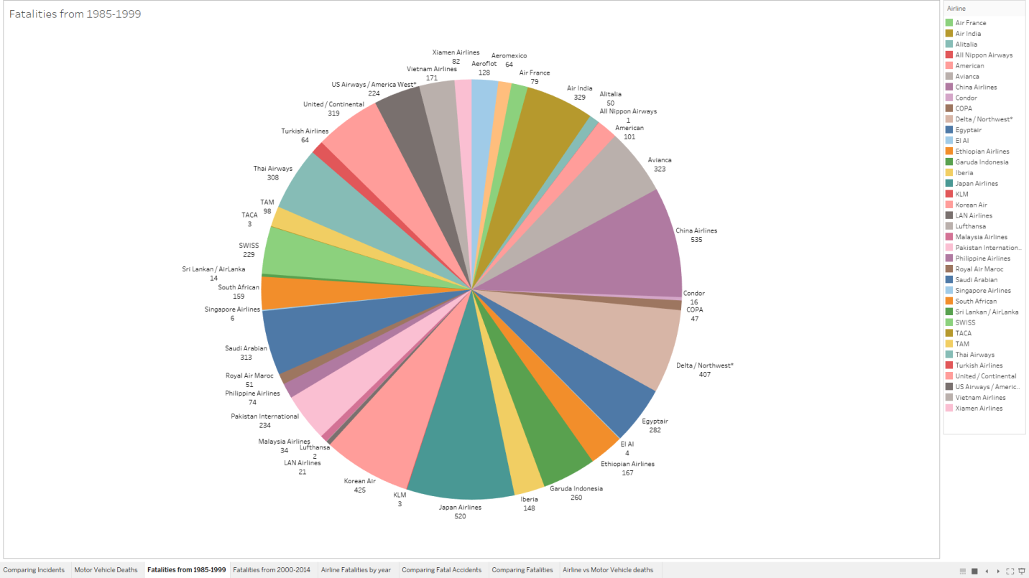
Airline Deaths from 1985-1999
Breakdown of all airlines and the number of deaths from 1985-1999.

Slide 7
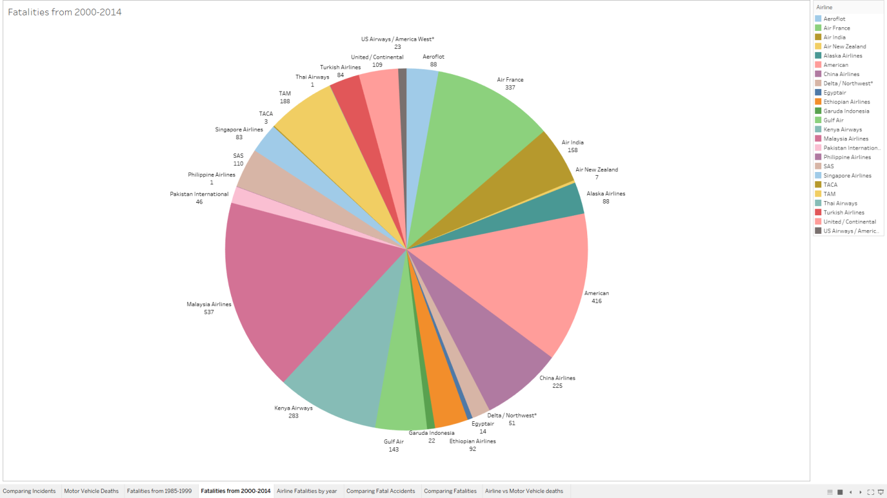
Airline Deaths from 2000-2014
Breakdown of all airlines and the number of deaths from 2000-2014.
Notice the smaller number of airlines compared to the number in the 1985-1999 pie chart, as well as the fewer deaths overall.

Slide 8
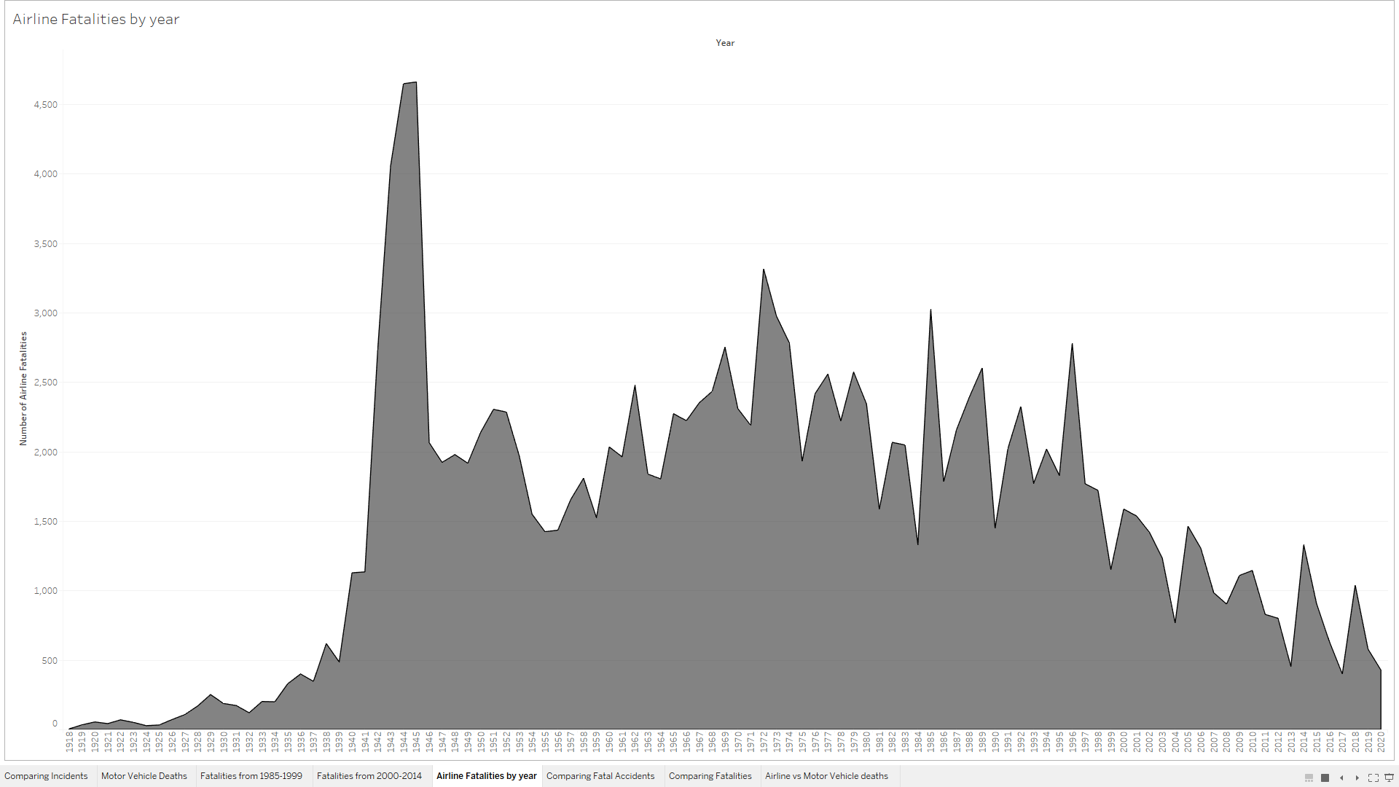
Airline Deaths from 1918 to 2010
The number of deaths did rise at first, but declined after the mid 1970’s with 2010 hitting the same low number of deaths as the early 1930’s did.

Slide 9
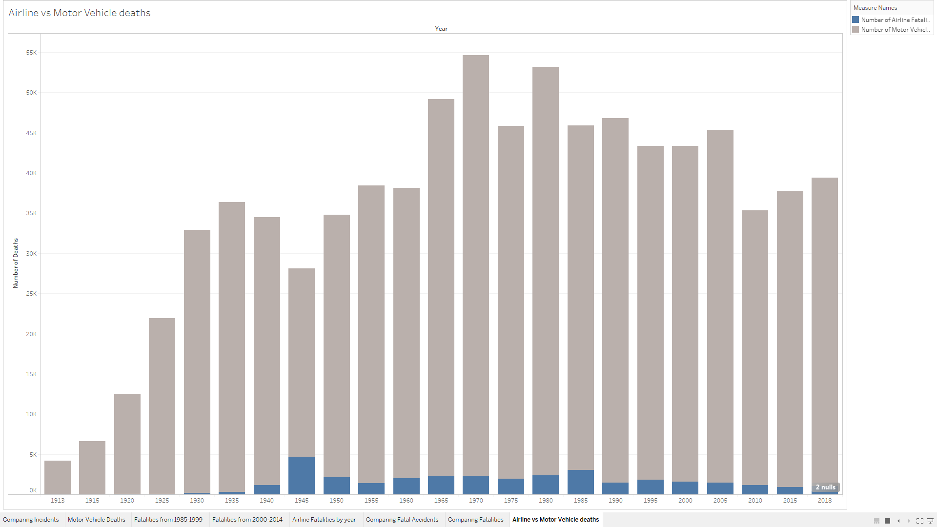
Airline vs. Motor Vehicle Deaths
The overall combined number of deaths every year from airlines and motor vehicles is mostly made up of motor vehicle deaths.
Notice how airline deaths, in blue, are much lower compared to motor vehicle deaths, in gray.

Slide 10
Conclusion
Airline incidents, fatal incidents, and fatalities are currently much lower compared to previous years.
There are many more motor vehicle deaths as compared to airline deaths.
Motor vehicle deaths have not been on a steady decline in recent years as airline deaths have.
The airline industry has received more negative press from far fewer deaths compared to motor vehicles, which are much more deadly.

